Slide 1

YOU ARE MY ALL IN ALL

Slide 2

VOCABULARY

Slide 3

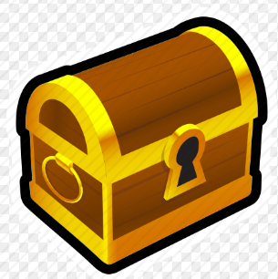

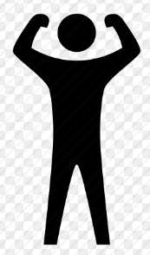

STRENGTH :
WEAK :
TREASURE :
SEEK :
ALL :

Slide 4




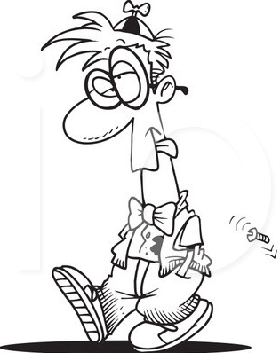

precious :
jewel :
give up :
fool :

Slide 5
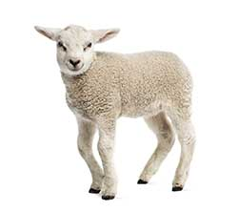

lamb :
worthy :

Slide 6
shame :
bless :
fall :
pick:
dry:
fill:

Slide 7

You are my strength
when I am weak You are the treasure that I seek You are my all in all

Slide 8

Seeking You as a precious jewel Lord to give up I'd be a fool You are my all in all

Slide 9
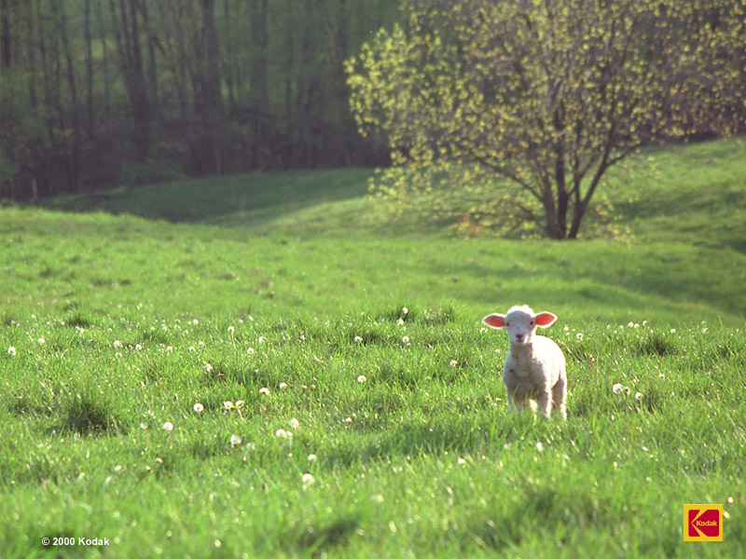
Jesus Lamb of God
worthy is your name Jesus Lamb of God
worthy is your name

Slide 10

Taking my sin
my cross my shame Rising again I bless your name You are my all in all

Slide 11

When I fall down
You pick me up When I am dry You fill my cup You are my all in all

Slide 12
Jesus Lamb of God
worthy is Your name Jesus Lamb of God
worthy is Your name

